Slide 1
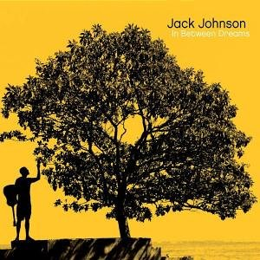
Jack Johnson
Banana Pancakes

Slide 2
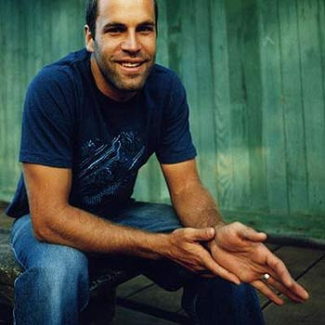
Jack Johnson
Aged 35
Film maker
Singer/ song writer!
Musician
Soft rock/ acoustic
Sold 4 million albums
Most famous for his song in curious George
Surfer
Film maker

Slide 3
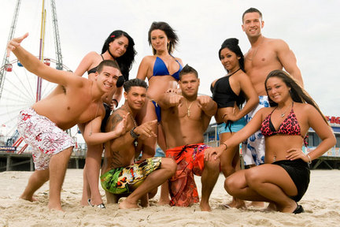
Audience profile
Camping
Cinema
Young
Beach
Male & Female
Party
Student
Outdoor
Low paid
Friends
Pizza
H & M
Music
Top shop
Surfer
Stylish

Slide 4
Video conventions
Special effects
Artist
Animation
Singing
Stop motion
Instruments
Storyline
Beach
Outdoor
Dance

Slide 5
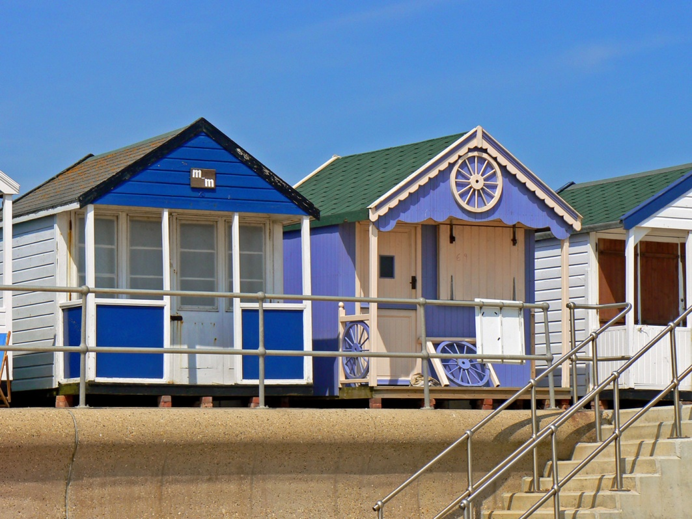
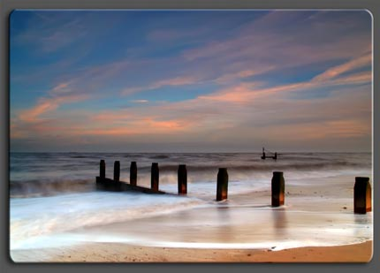
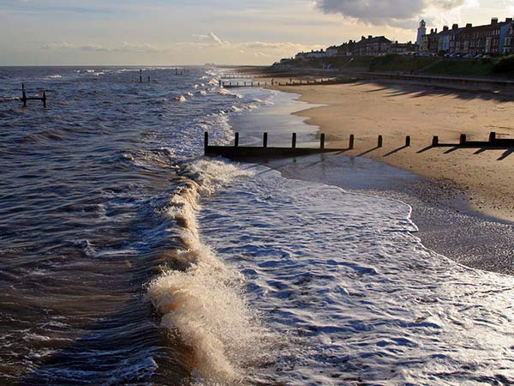
Setting

Slide 6
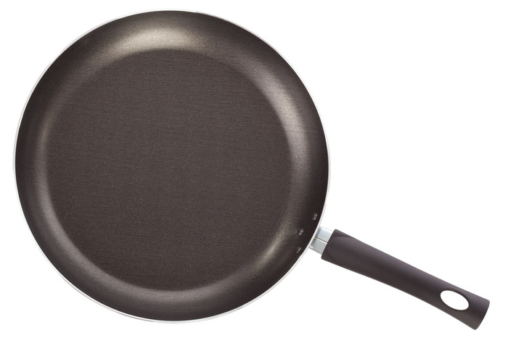
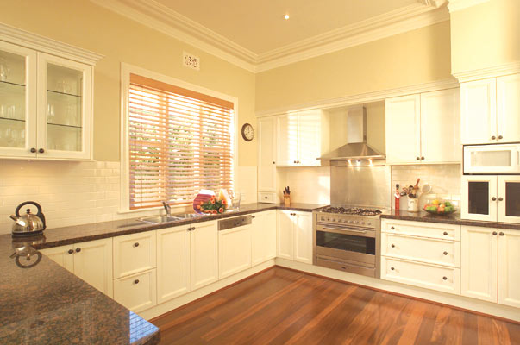
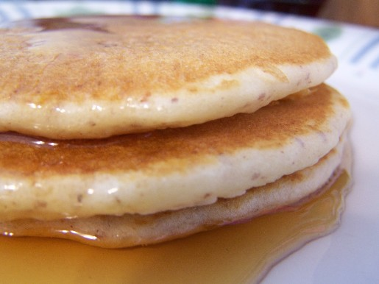
Kitchen

Slide 7
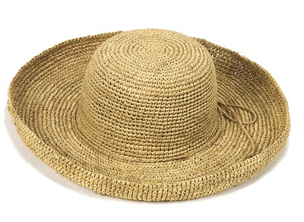
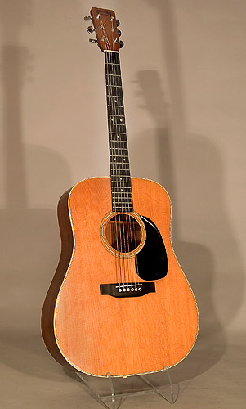
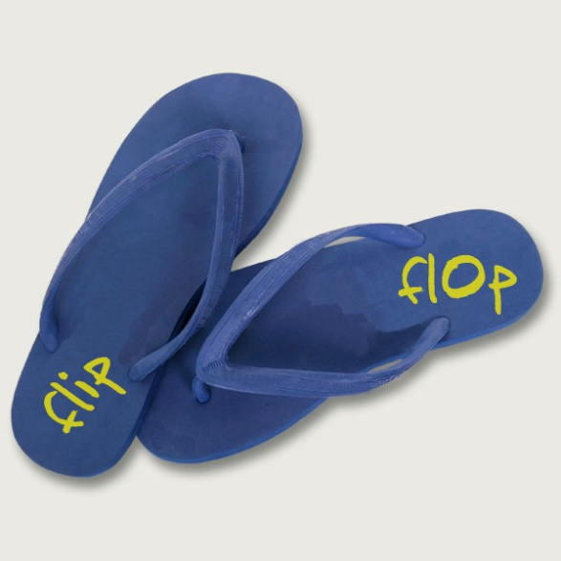
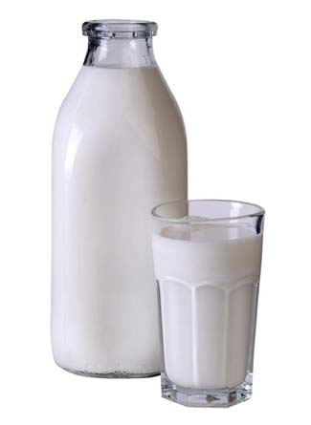
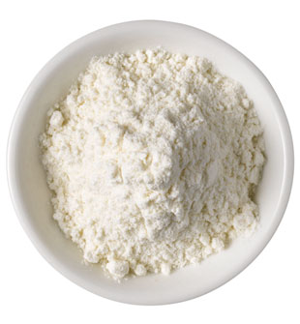
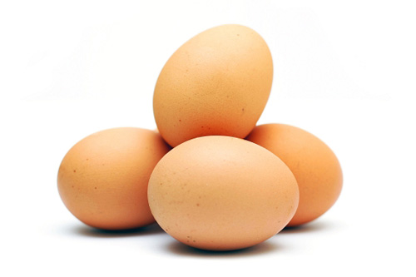
Props

Slide 8
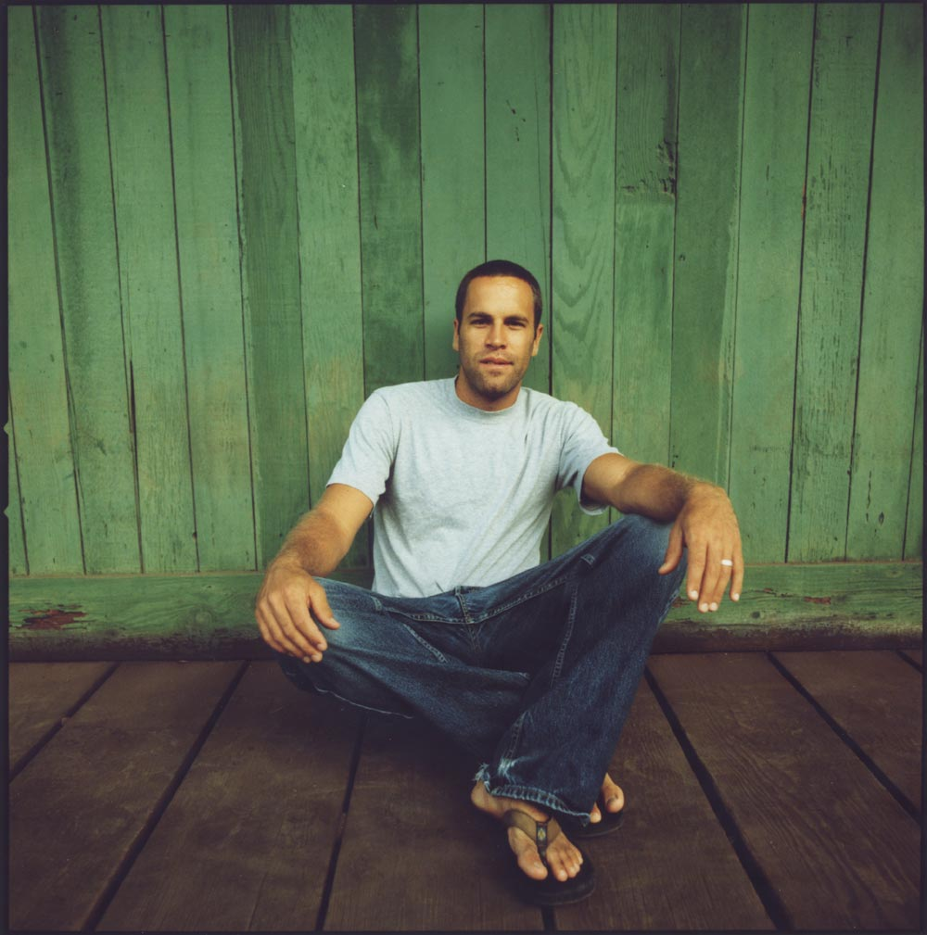
Actors

